Slide 1
Employee Data Analysis using Excel
STUDENT NAME:A.AFREEN
REGISTER NO:312212115
NM ID:DA7D994D4A02FCAB3E940F2338C191DE
DEPARTMENT:BCOM(general)
COLLEGE:Mar gregories college of arts and science

Slide 2
PROJECT TITLE
HR Analytics: Employee promotion Data

Slide 3
AGENDA
1.Problem Statement
2.Project Overview
3.End Users
4.Our Solution and Proposition
5.Dataset Description
6.Modelling Approach
7.Results and Discussion
8.Conclusion

Slide 4
PROBLEM STATEMENT
In HR Analytics,a problem statement for employee promotion data typically outlines the specific challenge or issue that the analysis aims to address.For example:
“Determine the key factors influencing employee promotions within the company to improve fairness and efficiency in the promotion process. Analyze historical promotion data to identify patterns,biases, and predictors of promotion success,with the goal of developing data-driven strategies to enhance career development opportunities and reduce turnover.”
This statement helps focus the analysis on understanding what drives promotions and how to optimize the process for better outcome.

Slide 5
PROJECT OVERVIEW
In HR Analytics for employee promotion data, a project overview typically provides a concise summary of the project's goals, scope, and methods.
Project Overview:
This project aims to analyze employee promotion data to understand the underlying factors influencing promotion decisions and to improve the overall effectiveness and fairness of the promotion process.
Data Collection and Cleaning: Gather and preprocess historical promotion data, including employee demographics, performance metrics, tenure, and promotion outcomes.
Exploratory Data Analysis (EDA): Examine the data to identify trends, patterns, and anomalies related to employee promotions.3. *Predictive Modeling:* Develop models to predict promotion outcomes based on various factors such as performance.

Slide 6
Predictive Modeling: Develop models to predict promotion outcomes based on various factors such as performance evaluations, skills, and experience.
Bias Detection: Analyze the data to uncover any potential biases in the promotion process, ensuring that promotions are based on merit and not influenced by factors like gender, ethnicity, or age.
Recommendations: Provide actionable insights and recommendations to enhance the promotion process, ensuring it aligns with best practices and organizational goals.

Slide 7
END USERS
The end users of HR Analytics for employee promotion data typically include:
HR managers:They use the insights to refine promotion policies,ensure fairness,and make data-driven decisions about employee development
Recruitment Teams:They benefit from understanding what factors contribute to successful promotions, which can help in attracting and retaining talent.
Executives and Leadership:They use the insights to align promotion strategies with organizational goals and to ensure that the promotion process supports business objectives.
Employees:They are indirectly affected as the analysis can lead to more transparent and equitable promotion practices, impacting their career growth opportunities.
Data Analysts/Consultants:They analyze the data and generate insights, providing actionable recommendations to the HR and leadership teams.

Slide 8
OUR SOLUTION AND PROPOSITION
The solution and proposition typically outline the recommended approach and benefits of the analysis. Here’s an example:
A.pivot table. B.graph.
A pivot table in Excel is a powerful tool for summarizing, analyzing, and presenting large sets of data. Here’s why you might use a pivot table:
Data Summarization: Pivot tables help quickly summarize large amounts of data by aggregating values (e.g., sums, averages) and providing an overview without needing complex formulas.
Dynamic Data Analysis: You can easily rearrange, filter, and drill down into data by dragging and dropping fields, which allows for flexible and dynamic data analysis.
Comparison: Pivot tables make it simple to compare different data segments side by side (e.g., sales by region or performance

Slide 9
by department).
Trend Identification: They allow you to identify trends and patterns in the data by summarizing it across various dimensions (e.g., time periods, product categories).
Data Filtering: Pivot tables offer powerful filtering options to focus on specific subsets of data, which helps in analyzing targeted information.
Visual Representation: You can create charts based on pivot tables to visually represent the summarized data, making it easier to interpret and present insights.

Slide 10
Graphs in Excel are used to visualize data, making it easier to understand and interpret complex information. Here’s why you might use graphs:
Enhanced Understanding: Graphs provide a visual representation of data, helping you quickly grasp trends, patterns, and relationships that might be less obvious in raw data.
Comparisons: They allow you to compare different data series or categories easily. For instance, bar charts or column charts can compare sales across regions.
Trend Analysis: Line graphs are useful for showing trends over time, making it easier to analyze changes and forecast future performance.
Data Presentation: Graphs make reports and presentations more engaging and easier to understand, which is helpful for communicating findings to stakeholders.
Highlighting Insights: Visualizations can highlight key insights or anomalies in the data, such as peaks, troughs, or outliers.

Slide 11
DATASET DESCRIPTION
A dataset description would include specifics about the dataset's attributes, structure, and any relevant metadata. Here’s an example description:
Dataset Description: Download from:kaggle
Dataset Name: Employee Promotion Data
Description:This dataset contains historical records of employee promotions, including employee demographics, performance metrics, promotion details, and other relevant attributes. It is used to analyze the factors influencing promotions and identify patterns or biases.
Data Fields:
Employee_ID:Unique identifier for each employee.

Slide 12
Name: Employee’s name (often anonymized in datasets).
Age: Employee’s age at the time of data collection.
Gender: Employee’s gender.
Ethnicity: Employee’s ethnic background.
Education_Level: Highest level of education attained by the employee.
Department: Department where the employee works.
Job_Title: Employee’s current job title.
Tenure:Number of years the employee has been with the company.
Performance_Score:Rating from performance evaluations (e.g., numerical score or categorical rating).
Training_Courses: List of training programs completed by the employee.
Promotion_Date: Date when the employee was promoted.
New_Job_Title: Job title received after promotion.
Promotion_Reason: Reason for promotion (if available).
Salary_Before: Salary before promotion.
Salary_After:* Salary after promotion.

Slide 13
Data Structure:
Format: Typically in a tabular format, such as a CSV or Excel file.
Rows: Each row represents an individual employee's record.
Columns: Each column represents a different attribute or metric.
Metadata:
Data Source: HR management systems, performance management systems, payroll systems, etc.
Collection Period: The time frame during which the data was collected.
Update Frequency: How often the data is updated (e.g., quarterly, annually).
Data Quality: Notes on data completeness, accuracy, and any potential limitations or missing values.
Privacy and Confidentiality:
Anonymization: Sensitive information like names and personal identifiers should be anonymized to ensure privacy.
Access Control: Restricted access to ensure data confidentiality and compliance with data protection regulations.

Slide 14
THE “WOW” IN OUR SOLUTION
The "wow" factor in your solution for HR Analytics employee promotion data could be:
Predictive Insights: Offering advanced predictive models that accurately forecast promotion outcomes based on performance, skills, and tenure, enabling proactive talent management.
Bias Detection: Implementing sophisticated algorithms to uncover and address biases in promotion decisions, promoting fairness and transparency.
Interactive Dashboards: Creating visually appealing, interactive dashboards that allow HR professionals and executives to explore data dynamically and derive insights on-demand.
Actionable Recommendations: Providing tailored, actionable recommendations based on data analysis to improve promotion processes, employee development, and retention strategies.
Real-Time Analytics: Delivering real-time data analysis and updates, ensuring that HR decisions are based on the most current information available.

Slide 15
MODELLING
HR Analytics for employee promotion data, modeling involves creating statistical or machine learning models to analyze and predict promotion outcomes.
Define Objectives:
Predictive Modeling: Predict which employees are most likely to be promoted based on historical data.
Bias Detection: Identify and quantify potential biases in the promotion process.
Data Preparation:
Data Cleaning: Handle missing values, outliers, and ensure consistency in the dataset.
Feature Engineering: Create relevant features such as performance metrics, tenure, and training completion. Normalize or transform variables as needed.

Slide 16
Model Selection:
Classification Models: Use models like logistic regression, decision trees, random forests, or gradient boosting machines to predict promotion likelihood.
Regression Models: For predicting continuous outcomes like salary increase post-promotion, linear regression or more advanced techniques like ridge or lasso regression may be used.
Anomaly Detection: Use models to detect unusual patterns or outliers that might indicate biases.
Model Training:
Split Data: Divide data into training and test sets to evaluate model performance.
Train Models: Fit models using the training data. This involves learning the patterns and relationships in the data.

Slide 17
Model Evaluation:
Performance Metrics: Assess models using metrics such as accuracy, precision, recall, F1 score (for classification), or mean squared error (for regression).
Cross-Validation: Use techniques like k-fold cross-validation to ensure model robustness and avoid overfitting.
Bias Analysis:
Fairness Metrics: Evaluate the models for fairness across different demographic groups to ensure equitable promotion practices.
Adjustments: Make necessary adjustments to the models or processes based on the findings.
Implementation:
Deploy Models: Integrate models into HR systems for real-time predictions and analysis.
Monitor and Update: Continuously monitor model performance and update as needed to adapt to changing data and organizational needs.

Slide 18
Visualization and Reporting:
Results Interpretation: Present model results using visualizations to make insights accessible to HR professionals and stakeholders.
Actionable Insights: Provide recommendations based on model outputs to improve promotion processes and address any detected biases.
By following these steps, you can build effective models that provide valuable insights into employee promotions and support data-driven decision-making.

Slide 19
RESULTS

Slide 20
Row Labels | Count of employee_id | Sum of previous_year_rating | Sum of awards_won? | Sum of age | Sum of avg_training_score
Analytics | 2524 | 7873 | 57 | 85555 | 178778
f | 584 | 1843 | 14 | 19679 | 39046
m | 1940 | 6030 | 43 | 65876 | 139732
department | 1629 | 5010 | 39 | 56749 | 102609
f | 540 | 1627 | 13 | 19008 | 34262
m | 1089 | 3383 | 26 | 37741 | 68347
Finance | 3656 | 11299 | 78 | 126012 | 229673
f | 1111 | 3517 | 28 | 38697 | 71153
m | 2545 | 7782 | 50 | 87315 | 158520
HR | 2012 | 6117 | 56 | 69631 | 122421
f | 672 | 2067 | 16 | 23515 | 40711
m | 1340 | 4050 | 40 | 46116 | 81710
Legal | 170 | 524 | 3 | 5758 | 10123
f | 23 | 54 | 0 | 733 | 1386
m | 147 | 470 | 3 | 5025 | 8737
Operations | 1784 | 6141 | 36 | 64351 | 107515
f | 749 | 2610 | 19 | 27059 | 45221
m | 1035 | 3531 | 17 | 37292 | 62294
Procurement | 4409 | 13653 | 104 | 155084 | 286325
f | 1554 | 4851 | 41 | 55008 | 102115
m | 2855 | 8802 | 63 | 100076 | 184210
R&D | 156 | 492 | 6 | 5082 | 13179
f | 8 | 17 | 0 | 236 | 673
m | 148 | 475 | 6 | 4846 | 12506
Sales & Marketing | 4345 | 12764 | 95 | 151257 | 239017
f | 995 | 2950 | 22 | 34577 | 55982
m | 3350 | 9814 | 73 | 116680 | 183035
Technology | 2784 | 8445 | 61 | 96774 | 195127
f | 914 | 2774 | 19 | 31875 | 65286
m | 1870 | 5671 | 42 | 64899 | 129841
Grand Total | 23469 | 72318 | 535 | 816253 | 1484767

Slide 21
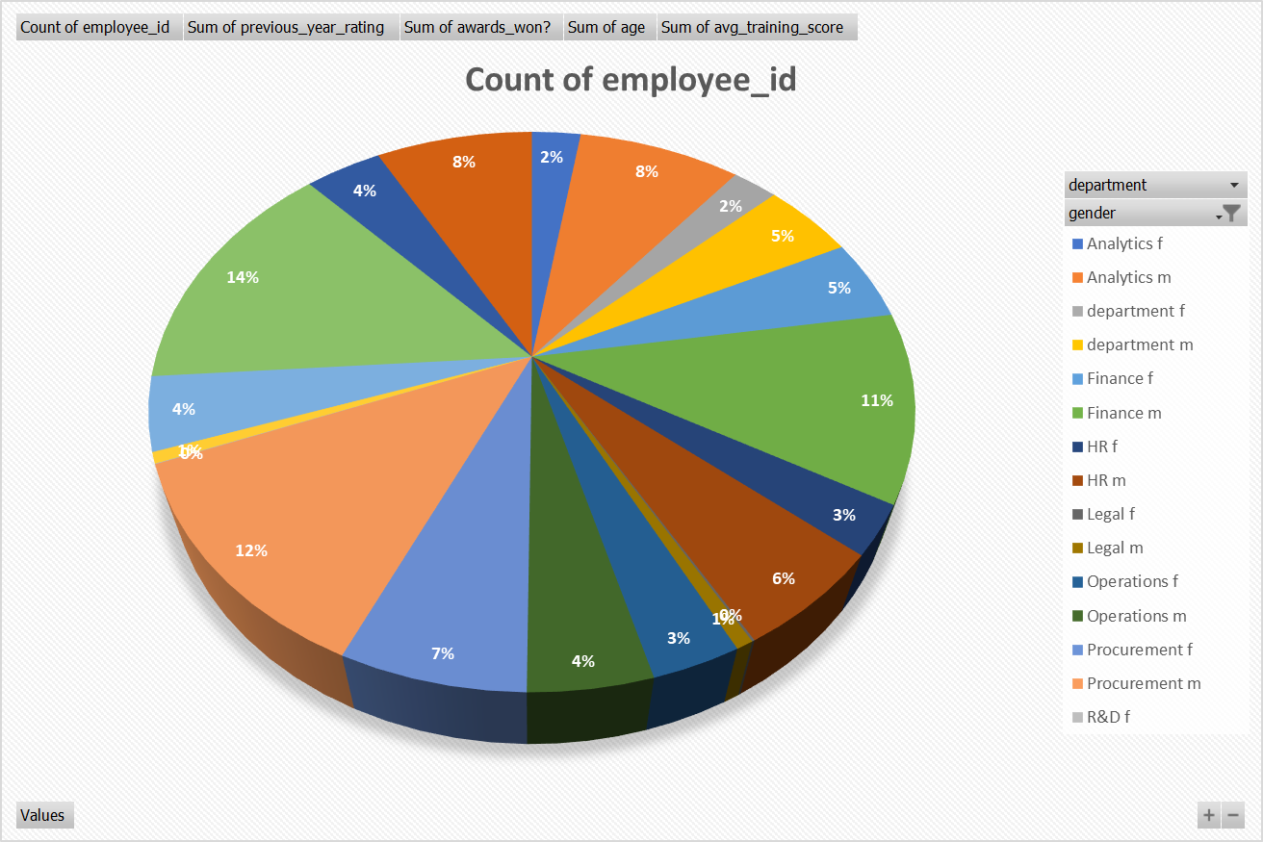

Slide 22
CONCLUSION
In conclusion, leveraging HR Analytics for employee promotion data through predictive modeling and bias detection offers substantial benefits for organizations.
Enhanced Decision-Making: Predictive models help HR departments make informed promotion decisions by forecasting potential outcomes based on historical data, which improves the accuracy and effectiveness of promotion strategies.
Fairness and Equity: Bias detection models identify and address any discrepancies in promotion practices, ensuring a fair and equitable process for all employees. This fosters a more inclusive work environment and promotes diversity.
Data-Driven Insights: By analyzing promotion data, organizations gain valuable insights into the factors driving successful promotions. This enables the development of targeted strategies for talent management, career development, and employee retention.

Slide 23
Dynamic and Flexible Analysis: Interactive dashboards and real-time analytics provide HR professionals with the tools to explore data dynamically, identify trends, and make timely adjustments to promotion practices.
Continuous Improvement: Ongoing monitoring and updating of models ensure that they remain relevant and effective as organizational needs and data evolve.
Overall, integrating advanced analytics into HR practices enhances the efficiency, fairness, and strategic impact of the promotion process, ultimately leading to a more engaged and satisfied workforce.

Slide 24


